Slide 1

Hadoop: HDFS, MapReduce, and YARN

Slide 2
Recall: Big Data Characteristics
Volume: data at rest
Velocity: data in motion
Variety: data in many formats
Veracity: uncertainty of data
Viability: the predictability of data
Value: Can it be derived?

Slide 3

What Is Hadoop?

Slide 4

What Is Hadoop?
A system for:
Storing data
Processing data
Managing data
Data
Sounds familiar?
Yes—change “data” to “big data”

Slide 5
Birthplace of Hadoop
Google, Facebook, Yahoo!
These companies had so much data that enterprise DBMSs could not meet their reporting requirements.
Time to process one day of data
24 hours

Slide 6

Hadoop: Scale out by Design
Problem: File too large to fit on a single storage platform?
Solution: Split the file into blocks, then distribute the file over several computers.
Problem: Server not “fast” enough to process your data?
Solution: Distribute data processing over several computers.
Problem: Need more storage or compute power?
Solution: Add more nodes!
Data
Data
Compute
Compute

Slide 7
Hadoop vs. RDBMS
Assumes that a task will require reading a significant amount of data off of a disk
Does not maintain any data structure
Simply reads the entire file
Scales well (increase the cluster size to decrease the read time of each task)
Uses indexes to avoid reading an entire file (very fast lookups)
Maintains a data structure in order to provide a fast execution layer
Works well as long as the index fits in RAM
2,000 blocks of size 256 MB
1.9 seconds of disk read for each block
On a 40-node cluster with eight disks on each node, it would take about 14 seconds to read the entire 500 GB
500 GB
data file
61 minutes to read this data off of a disk (assuming a transfer rate of 1,030 Mbps)
Notes:
Don’t worry too much about the details or math on this slide. The purpose is to show that reading a file that is scaled across a cluster is obviously much faster than trying to read it on a single machine.

Slide 8

Hadoop Is Designed to Use Commodity Hardware
Hadoop hardware
Modular
Easy to add and remove nodes
Failure is acceptable
This is contrary to enterprise hardware
High-redundancy/fault-tolerant
Vertical scaling
Storage arrays
*Google hardware spec for server source: C|NET

Slide 9


Hadoop Cluster Nodes
Master Nodes
Manages the Hadoop infrastructure
Runs one of each of these services per cluster, on a single server or many
Should run on server-class hardware
A few of these
YARN:
App Timeline Server,
Resource Manager,
History Server*
HDFS:
NameNode
YARN: Node Manager
HDFS: DataNode
YARN: Node Manager
HDFS: DataNode
YARN: Node Manager
HDFS: DataNode
Worker Nodes
Store data and perform processing over it
Each node runs the same services
Runs on commodity hardware
Many of these
YARN: Node Manager
HDFS: DataNode
YARN: Node Manager
HDFS: DataNode
YARN: Node Manager
HDFS: DataNode
*MapReduce 2 service on YARN

Slide 10

Hadoop Data Model

Slide 11
Hadoop Data Are…
Time-variant: reflect that point in time
Non-volatile: not updated
Subject-oriented: stored by topic
Examples:
Web logs, sales transactions, event records, sensor data

Slide 12


Hadoop Data Lake
Business Application or Data Mart
Data lake is an industry term for:
Vast amounts of data
Sorted in raw, native format
Notes:
Like a real lake the water is unprocessed and vast
The water is sourced from streams (data lake from streams of data sources)
Compare this to a bottle of water which is filter, packaged and processed for consumption – like the highly structured data associated with a business application or data mart.

Slide 13
The Hadoop Philosophy
Capture the data “as are” and store them.
Do not transform before you store them.
Store all the data, as you don’t know what you’ll need.
Transform them when you query them.
This is the anti-pattern of relational modeling!
Notes:
where we design a database structure with storage and query in mind. We do heavy transformations as the data is written, not as it is read.

Slide 14
How Does Hadoop Differ From Relational?
Relational
Hadoop
Schema on write
Fast reads
Highly structured data
Declarative data processing (SQL)
Good for ACID transactions, business data
Schema on read
Fast writes
Loosely structured data
Declarative and procedural data processing
Good for logs, data streams, unstructured data discovery

Slide 15
Example: Hadoop Way of Doing Things

Slide 16
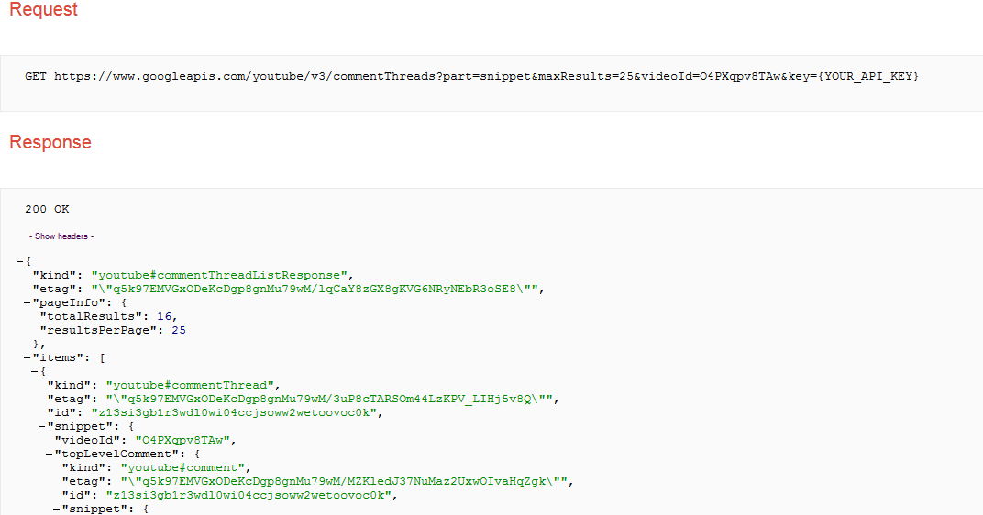
Collect and Store Data as They Are—Schema-Less
Hadoop Worker Nodes
Hadoop Worker Nodes
Hadoop worker nodes
Notes:
Common use case of Hadoop is collect output from another system, and store it as is because you don’t know how you want to analyze it yet.
You don’t know what parts of the JSON output you will need. This data is schema-less which means we don’t have to apply any logic at write-time as we would normally with a relational database management system.

Slide 17

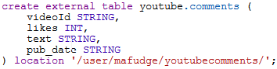
Apply a Schema on Read/Query
videoId | likes | text | pub_date
O4PXqpv8TAw | 0 | excellent video!\ufeff | 2015-02-02T02:05:16.042Z
… | … | … | …
Notes:
When we want to perform analysis on our data, we apply a schema as it is read to that it can be placed in a tabular form for analysis.
You don’t have to define a full schema to all the data – only the data you care about.
Once the schema is applied we can further process the data in tabular format.

Slide 18
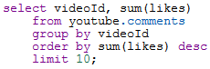
Analyze Your Data
videoId | likes | text | pub_date
O4PXqpv8TAw | 0 | excellent video!\ufeff | 2015-02-02T02:05:16.042Z
… | … | … | …
Export/ Visualize
videoId | sum(likes)
O4PXqpv8TAw | 56
V56Xqyy-2wq | 14
… | …
Notes:
When your data is in tabular format you can process it further and then visualize it.
Hadoop has tools to visualize your data, you can also export the data, provided it has been reduced to a reasonable side.
The entire process can be automated so that as new data is collected it can be processed and visualized.

Slide 19
What Exactly Is “Schema on Read”? Again?
Traditional RDBMS
You cannot write data without a table
Cannot insert data unless data fit into table’s single design
Large up-front design costs
Conceptual models
Table design
“Schema on write”
Hadoop’s HDFS
You write the data “as they are” to HDFS
Schema applied when data are read—multiple designs
Very little up-front design costs
Just write to disk
Apply schema when you need it
“Schema on read”

Slide 20
Hadoop Components

Slide 21
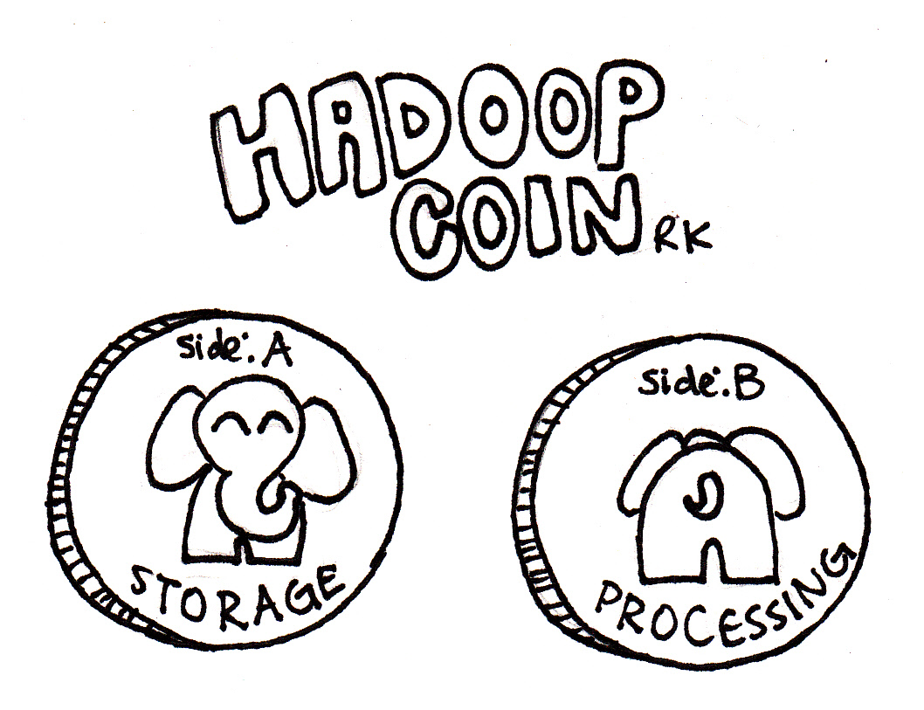
Two Essential Components of Hadoop
Distribute the data by splitting it up. HDFS does this.
Move the compute to the data. MapReduce/YARN does this.

Slide 22
HDFS
Distributed data storage paradigm
A single file is divided into blocks
Blocks are spread across nodes
Blocks are written multiple times for redundancy
A
B
C
Worker node 1
Worker node 2
Worker node 3
Worker node 4
A
B
C
A
B
C

Slide 23
MapReduce
A programming model for large-scale distributed data processing
Foundations in functional programming, LISP
Map → apply a transformation to a data set
Shuffle → transfer output from Mapper to Reducer nodes
Reduce → aggregate items into a single result
Combine → output of Reducer nodes into single output
In Hadoop 2.0, MapReduce programs use HDFS and YARN
Map
Shuffle
Reduce
Combine

Slide 24
Hadoop MapReduce: “Total Orders by State”
Source
file
HDFS blocks each node
Mapping
Shuffle
Reduce
Combine
JAN, NY, 3
JAN, PA, 1
JAN, NJ, 2
JAN, CT, 4
FEB, PA, 1
FEB, NJ, 1
FEB, NY, 2
FEB, VT, 1
MAR, NJ, 2
MAR, NY, 1
MAR, VT, 2
MAR, PA, 3
JAN, NY, 3
JAN, PA, 1
JAN, NJ, 2
NY, 3
PA, 1
NJ, 2
CT, 4
NJ, 2 NJ, 1 NJ, 2
CT, 4 NJ, 5
JAN, CT, 4
FEB, PA, 1
FEB, NJ, 1
CT, 4
PA, 1
NJ, 1
CT, 4 NJ, 5
NY, 6
PA, 5
VT, 3
NY, 3
NY, 2
NY, 1
NY, 6
FEB, NY, 2
FEB, VT, 1
MAR, NJ, 2
NY, 2
VT, 1
NJ, 2
PA, 1 PA, 1 PA, 3
PA, 5
MAR, NY, 1
MAR, VT, 2
MAR, PA, 3
NY, 1
VT, 2
PA, 3
VT, 1 VT, 2
VT, 3
Notes:
Let’s start with a source file. This file contains the month and state and count of orders for that month/state. We would like to process this “big data” and get a count of total orders by state For example if you add up the NY orders it would be 6.
When this file is uploaded to HDFS it is broken up into blocks. The blocks are split evenly across the block size. In this example the block size chosen results in 4 blocks, conveniently one block per node. This is not always the case – just how it works out in this example.
Next we perform a mapping. The mapping phase uses the key State code to return a list of order counts. For example On the first node “NY” returns a one item list of NY,3.
Next we must move data to the reducer nodes. This is called a shuffle. The shuffle can be the most I/O intensive part of the process. In this example we have 4 reducer nodes (the same number of mappers and data nodes) data is shuffled to reducer so that each node can process its data in parallel.
In the reduce phase we take our key and apply an aggregate function to the data. For example in this case if we look at the first reducer node it will sum up the orders by key state.
At this point the map-reduce is complete and 4 files are written to HDFS (one for each reducer) we can combine these files easily to produce a single output.

Slide 25
Minimal Shuffle: Orders for Each Month
Source
file
HDFS blocks each node
Mapping
Shuffle
Reduce
Combine
JAN, NY, 3
JAN, PA, 1
JAN, NJ, 2
JAN, CT, 4
FEB, PA, 1
FEB, NJ, 1
FEB, NY, 2
FEB, VT, 1
MAR, NJ, 2
MAR, NY, 1
MAR, VT, 2
MAR, PA, 3
JAN, NY, 3
JAN, PA, 1
JAN, NJ, 2
JAN, 3
JAN, 1
JAN, 2
JAN, 3
JAN, 1
JAN, 2
JAN, 4
JAN, 10
JAN, CT, 4
FEB, PA, 1
FEB, NJ, 1
JAN, 4
FEB, 1
FEB, 1
FEB, 1
FEB, 1
FEB, 2
FEB, 1
JAN, 10
FEB, 5
MAR, 8
FEB, 5
FEB, NY, 2
FEB, VT, 1
MAR, NJ, 2
FEB, 2
FEB, 1
MAR, 2
MAR, NY, 1
MAR, VT, 2
MAR, PA, 3
MAR, 1
MAR, 2
MAR, 3
MAR, 2
MAR, 1
MAR, 2
MAR, 3
MAR, 8
Notes:
In this example, we perform a Map-Reduce on the same data, but instead key on month. Since the data is organized by month by default, the minimizes the amount of shuffling required. This is something to consider when storing data in Hadoop, and often we will take the same “big data” and use map-reduce to re-write it in different formats to improve the performance of our big data queries.

Slide 26
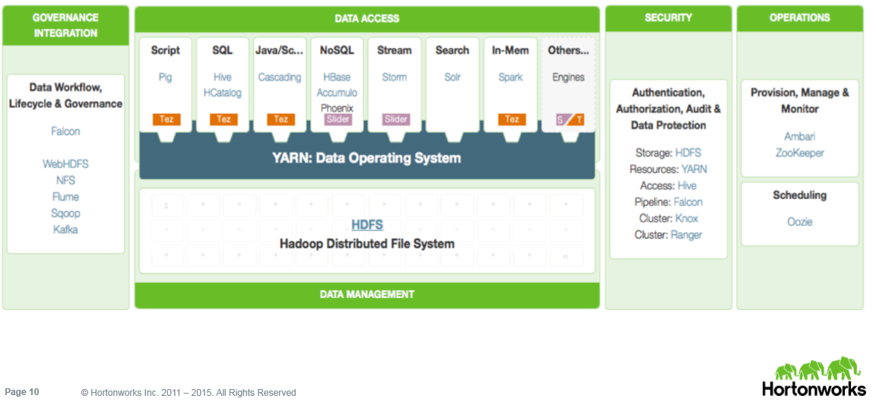
Today’s Hadoop Is an Ecosystem
… A Suite of Distributed Technologies
Notes:
Hadoop is more than HDFS and Map-Reduce.

Slide 27


An Oversimplified Version of the Hadoop Ecosystem in Action
Relational business data
Sqoop: ingest relational data
HDFS Data Lake Data stored “as is”
Pig, Spark: explore data,
transform data, add structure
Flume: ingest logs and data streams
Unstructured data (logs, social, text, etc.)
Mahout, Spark MLlib, R: mine structured data for predictive and prescriptive analytics
Hive, Impala, Spark-SQL: ad-hoc query structured data for descriptive and diagnostic analytics

Slide 28
Introduction to HDFS

Slide 29
HDFS: Hadoop Distributed File System
Based on Google’s GFS
Data distributed over physical nodes
Designed for failover
Data stored “as they are”
Data split into blocks
Default replication factor is 3 (1 original and 2 copies)
Single-master system—a few “master” nodes orchestrate the I/O to the data nodes
Consistent and partition-tolerant

Slide 30

Designed for Failover
“I have a 200 TB file that I need to store.”
“Wow! That is big data! I will need to distribute that across a cluster.”
“Sounds risky! What happens if a drive fails?”
Hadoop client
HDFS
“No need to worry! I am designed for failover.”
Notes:
We will see how this works over the next few slides.

Slide 31
HDFS Components
NameNode
Is the “master” node of HDFS
Determines and maintains how the chunks of data are distributed across the DataNodes
DataNode
Stores the chunks of data and is responsible for replicating the chunks across other DataNodes
Notes:
A NameNode represents a single namespace
Data never resides on the NN, only on the DNs
Default block size in HDP is 128MB
Default replication factor is 3

Slide 32
Namenode and Datanode Responsibilites

Slide 33


HDFS NameNode Overview
Big data
Client sends a request to the NameNode to add a file to HDFS
NameNode
NameNode tells client how and where to distribute the blocks
The NameNode only stores file system metadata. It is not responsible for storing or transferring data!
Client breaks the data into blocks and writes each block to a DataNode
DataNode 1
DataNode 2
DataNode 3
The DataNode replicates each block to two other DataNodes (as chosen by the NameNode)
Notes:
Notice that the data never actually passes through the NameNode. The client program that is uploading the data into HDFS performs I/O directly with the DataNodes. The NameNode only stores the metadata of the filesystem, but is not responsible for storing or transferring the data.

Slide 34
HDFS: DataNode
Handle I/O requests from clients
Sending heartbeats and block reports to NameNode
Managing the blocks themselves (create, delete, replicate)
NameNode
“I’m here, too! And here is my latest block report.”
“Replicate block 123 to DataNode 1.”
DataNode 1
DataNode 2
DataNode 3
DataNode 4
123
Notes:
The DataNodes are responsible for:
- Handling read and write requests from application clients
- Performing block creation, deletion, and replication upon instruction from the NameNode (The NameNode makes all decisions regarding replication of blocks)
- Sending heartbeats to the NameNode
- Sending a Blockreport to the NameNode

Slide 35
HDFS: Examples and Failover

Slide 36
Example: HDFS Write
Client put file: data.csv
NameNode
That’s 4 blocks on nodes 1-4
1
2
3
1
3
2
4
3
2
DataNodes
4
3
1
4
2
1
4
5
6
Notes:
In this example we have a single namenode and 6 data nodes in our cluster.
Client makes a request to the name node to write a file.
Name node stores metadata about the file’s whereabouts (data.csv consists of 4 blocks on nodes 1-4) and instructs the client where to write the file.
The client sends its data to the data nodes. Data is written in parallel so the I/O is vastly improved over non distributed options
Each data node replicates (make a copy of its’ block) to other datanodes as instructed by the Namenode. In this example there is a replication factor of 3, so two copies are made.

Slide 37
Example: HDFS Read
Client put file: data.csv
NameNode
That’s 4 blocks on nodes 1-4
1
2
3
4
1
2
3
1
3
2
4
3
2
DataNodes
4
3
1
4
2
1
4
5
6
Notes:
In this example we have a single namenode and 6 data nodes in our cluster.
Client makes a request to the name node to read a file.
Name node knows where the data is located. The datanodes are reporting “what they have” to the name node on an interval.
The client requests the data in parallel from the data nodes.
The data in assembled in the right order by the client.

Slide 38
HDFS: Heartbeat and Block Report
“Sorry, DataNode 3, but I’m going to assume you are dead.”
NameNode
Heartbeat and block report
Heartbeat and block report
Heartbeat and block report
DataNode 1
DataNode 2
DataNode 3
DataNode 4
HDFS DataNodes send routine heartbeats and block reports to the NameNode.
This is how the NameNode knows where the blocks of a file are located.
Notes:
- If a DataNode fails to send a Heartbeat to the NameNode, that DataNode is labeled as dead
- Any data that was registered to a dead DataNode is not available to HDFS anymore
- The NameNode does not send new I/O requests to a dead DataNode, and its blocks are replicated to live DataNodes

Slide 39
Example: HDFS Failover
Client put file: data.csv
NameNode
4 blocks on nodes 1,3,4 and 5
No Heartbeat! Node 2 down!
1
2
3
4
1
2
3
1
3
2
4
3
2
DataNodes
4
3
1
4
2
1
4
5
6
Notes:
Once again with our cluster
Node 2 goes down, as the namenode has yet to see a heartbeat. Its No big deal as we have blocks 2 and 4 replicated to nodes 3/6 and 4/5 respectively.
Client requests a file. Namenode reports block from available nodes to get the file.
The rest happens as expected.

Slide 40

HDFS Commands

Slide 41
HDFS Commands
hdfs dfs –command [args]
Here are a few (of the almost 30) HDFS commands:
-cat: displays file content (uncompressed)
-text: just like cat but works on compressed files
-chgrp,-chmod,-chown: changes file permissions
-put,-get,-copyFromLocal,-copyToLocal: copies files from the local file system to the HDFS and vice versa
-ls, -ls -R: list files/directories
-mv,-moveFromLocal,-moveToLocal: moves files
-stat: statistical information for any given file (block size, number of blocks, file type, etc.)
Note: replacement for “Hadoop fs”
Notes:
Concerted effort to move from “hadoop fs” to “hdfs dfs”. http://hadoop.apache.org/docs/current/hadoop-project-dist/hadoop-common/FileSystemShell.html states that “hdfs dfs” is a synonym for “hadoop fs” when HDFS is being used (i.e. the “hadoop fs” command can interact with other file systems that Hadoop supports such as local FS, HFTP FS, S3 FS, and “others”) which makes sense with HDP.
Feel free to demo some of these if time allows.

Slide 42
Examples of HDFS Commands
hdfs dfs -mkdir mydata
hdfs dfs -put numbers.txt mydata/
hdfs dfs -ls mydata
Remember: This takes effect in HDFS (not locally) and uses the identity of the current user.

Slide 43
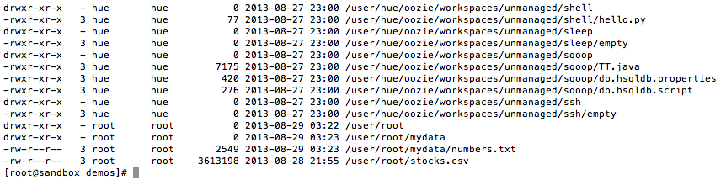
HDFS File Permissions—Like Linux Permissions
Files and directories have owners and groups
r = read
w = write
x = permission to access the contents of a directory
Notes:
- For files, the r permission is required to read the file and the w permission is required to write or append to the file
- For directories, the r permission is required to list the contents of the directory, the w permission is required to create or delete files or directories, and the x permission is required to access a child of the directory.

Slide 44
Demo: HDFS Commands
Assume the identity of the user
File system
Put files
Copy
Delete
Combine with cat
Combine with getmerge
Notes:
# need to be the cloudera user. In basic Hadoop security the current logged on user has the same permissions in HDFS
$ su cloudera
# Basic Commands
$ hdfs dfs –command
OR
$ Hadoop fs –command
# what is the current directory?
$Hadoop fs –ls
# its /user/cloudera
# make a folder
$ Hadoop fs –mkdir grades
# upload to Hadoop
$ Hadoop fs –put *.tsv grades/
# copy a file
hadoop fs -cp grades/fall2015.tsv grades/foo.tsv
# combine with cat
Hadoop fs –cat grades/*
# make a file with getmerge – a useful command when a reducer produces more than one fgile
Hadoop fs –getmerge grades/* allgrades.tsv

Slide 45
The .Trash
You can configure Hadoop’s HDFS to perform a soft delete
All files are moved into a .Trash folder, where they remain for a configurable interval
Prevents accidental deletion of data that may be unrecoverable
Turned off by default

Slide 46
Demo: HDFS Block Storage
Let’s understand block storage by example
See the blocks occupied by a file
Split a file into blocks
One node cluster—not a very good example ☹
Notes:
# see blocks in a file
Hdfs fsck /user/cloudera/grades/fall2015.tsv
# one block
# let’s put a larger file but and split it into 512 byte blocks.
Hadoop fs –D dfs.blocksize=512 –put sr20160401.csv nyc311/
# vblock size too small
Hadoop fs –D dfs.blocksize=1048576 –put sr20160401.csv nyc311/
# check the number of blocks
hdfs fsck /user/cloudera/nyc311/sr20160401.csv

Slide 47
Getting Data Into HDFS
Integrations

Slide 48






Options for Data Ingestion
HDFS
hdfs dfs put
MapReduce
WebHDFS
Connectors to RDBMS
Oracle, Teradata,
SQL Server, and others
Notes:
Spend as much (or as little) time as you like on this slide.
Best Practice: keep your big data in its raw format and worry about applying structure and schema to it later when you transform and analyze the data.

Slide 49
When Integrating…
Remember the “Hadoop way.”
Store data “as they are” (the way they were extracted from their source).
Store common data sets/entities in a folder, not a file.
Write the “entire story.”
Apply a schema to the data when it’s read from HDFS.
Notes:
For example when you are writing shipment data, you should not only include the obvious: what was shipped, when was it shipped, how it was shipped but also include the “at that time” related data such as who shipped it, who it was shipped to, where is was shipped, etc.

Slide 50
WebHDFS
REST API for accessing all of the HDFS file system interfaces:
http://host:port/webhdfs/v1/test/mydata.txt?op=OPEN
http://host:port/webhdfs/v1/user/root/data?op=MKDIRS
http://host:port/webhdfs/v1/test/mydata.txt?op=APPEND
Notes:
Feel free to demo WebHDFS:
curl -i "http://sandbox:50070/webhdfs/v1/user/root?op=LISTSTATUS”
curl -i -X PUT "http://Hadoop-cluster:50070/webhdfs/v1/user/ischool/constitution.txt?op= CREATE&blocksize=1048576&user.name=ischool”
curl -i -PUT -T constitution.txt "http://node4:50075/webhdfs/v1/user/ischool/constitution.txt?op=CREATE&namenoderpcaddress=node1:8020&blocksize=1048576&overwrite=false&user.name=root "

Slide 51
Why Store Content in Folders?
HDFS is designed for read and append, not overwrite
We can treat the folder as if it were a file
It’s easier to deal with all files as a single entity because they’re in a folder
Example:
Website log files

Slide 52
Flume

Slide 53
Flume
Flume is a distributed, reliable system for moving data
Source: where the data come from
Sink: where the data end up (HDFS)
Agent: process that moves data from source to sink
Channel: the queueing mechanism so that data are not lost as they travel from source to sink

Slide 54

Flume Architecture
Channel
Log data,
event data,
social media,
and so on
Source
Sink
Flume agent
Flume uses a channel between the source and sink to decouple the processing of events from the storing of events (the producer–consumer model).
Notes:
A Channel drains into a Sink, but because it is asynchronous the Channel is not required to send events to the Sink at the same rate that it receives them from the Source.
https://flume.apache.org/FlumeUserGuide.html

Slide 55
Flume Source Types
Exec: a long-running process; new data to STDOUT are consumed by the agent
Spooldir: watches a directory for new files and consumes them by the agent as they are created
Taildir: watches the files in a directory and consumes new data by the agent as they are appended to the file
Netcat: opens a port and listens for data; new data are consumed by the agent
Others: Twitter, Kafka, JDBC

Slide 56
Flume Sink Types
HDFS: write data to HDFS
File roll: stores the data to the filesystem
Others: Kafka, Solr, HBase, ElasticSearch

Slide 57
Flume Channel Types
Memory: messages are queued in memory
File: channel data persists to a file
Spillable memory: messages are queued in memory and spill over to disk after a certain amount
Others: Kafka, JDBC

Slide 58
A Flume Example
flume-ng agent -n my_agent -c conf -f myagent.conf
my_agent.sources = webserver
my_agent.channels = memoryChannel
my_agent.sinks = mycluster
my_agent.sources.webserver.type = exec
my_agent.sources.webserver.command = tail -F /var/log/security/audit.log
my_agent.sources.webserver.batchSize = 1
my_agent.sources.webserver.channels = memoryChannel
my_agent.channels.memoryChannel.type = memory
my_agent.channels.memoryChannel.capacity = 10000
my_agent.sinks.mycluster.type = hdfs
my_agent.sinks.mycluster.channel = memoryChannel
my_agent.sinks.mycluster.hdfs.path = hdfs://127.0.0.1:8020/security_audit/
Notes:
The command to start an Agent looks like: flume-ng agent -n my_agent -c conf -f myagent.conf
- The name of the Agent is my_agent
- The names of the Sink, Source, and Channel are arbitrary
- This Flume Agent has one Source named webserver
- The webserver Source is of type exec, which means it executes a given Unix command. In this example, it executes the tail command on the httpd access log file
- The Agent has one Sink named mycluster, which sends the events to a sequence file in a specified folder in HDFS
- The Agent has one Channel named memoryChannel
- The memoryChannel is configured with a memory type, which means it stores the events in memory. Notice that it is configured with a capacity of 10,000. No more than 10,000 events can fit in this Channel

Slide 59
Demo: Flume
Logagent.conf
Start a stream of tweets
Set up Flume to Ingest data into HDFS
View data in HDFS
Channel
Tweet
Stream
Source
Sink
HDFS: flumetweets/
Flume agent

Slide 60
Sqoop

Slide 61

Sqoop
Sqoop is a data transfer tool, designed to move data between RDBMS and Hadoop.
Sqoop runs on a Hadoop client.
It uses JDBC middleware to connect to the RDBMS.
It can be used to:
Import data into HDFS.
Export data from HDFS.

Slide 62


Overview of Sqoop
Relational database
Enterprise
data warehouse
Document-based
systems
Client executes a sqoop command
Plugins provide connectivity to various data sources
Sqoop executes the command as a MapReduce job on the cluster (using map-only tasks)
Map
tasks
Hadoop cluster
Notes:
Sqoop uses MapReduce to distribute its work across the Hadoop cluster:
- The sqoop command line executes a Sqoop job
- Map tasks (4 by default) execute the command in Sqoop
Plugins are used to communicate with the outside data source.
http://sqoop.apache.org/docs/1.4.5/SqoopUserGuide.html

Slide 63
Sqoop Commands
List-databases—list databases on server
List-tables—list tables on server
Eval—execute an SQL query
Import
Export
Merge

Slide 64
Demo: Sqoop Basics
Connecting to MySQL
Connecting to MSSQL (similar)
List database
List tables
Execute a query on a database with eval

Slide 65
Import Data With Sqoop

Slide 66
The Sqoop Import Tool
The import command has the following requirements:
must specify a connect string using the --connect argument
Credentials can be included in the connect string, so use the --username and --password arguments
Must specify either a table to import using --table or the result of an SQL query using --query
Notes:
The import command has the following requirements:
- Must specify a connect string using the --connect argument
- Can include credentials in the connect string, using the --username and --password arguments
- Must specify either a table to import using --table or the result of an SQL query using --query

Slide 67
Importing a Table
sqoop import
--connect jdbc:mysql://host/nyse
--table StockPrices
--target-dir /data/stockprice/
--as-textfile
Notes:
- The connect string in this example is for MySQL. The database name is nyse
- The --table argument is the name of the table in the NYSE database
- The --target-dir is where the data will be imported into HDFS
- The default number of map tasks for Sqoop is 4, so the result of this import will be in 4 files
- The --as-textfile argument imports the data as plain text

Slide 68
Importing Specific Columns
sqoop import
--connect jdbc:mysql://host/nyse
--table StockPrices
--columns StockSymbol,Volume, High,ClosingPrice
--target-dir /data/dailyhighs/
--as-textfile
--split-by StockSymbol
-m 10
This is used to distribute the values evenly among the mappers. So that each mapper has the same amount of work.
Notes:
How many columns will be in imported? (3)
How many files will be created in /data/dailyhighs/? (10)
Which column will Sqoop use to split the data up between the mappers? (the StockSymbol column)

Slide 69
Importing From a Query
sqoop import
--connect jdbc:mysql://host/nyse
--query "SELECT * FROM StockPrices s
WHERE s.Volume >= 1000000
AND \$CONDITIONS"
--target-dir /data/highvolume/
--as-textfile
--split-by StockSymbol
A special variable to split data through mappers
If you use --query, then you must also specify a split-by column or the command will fail to execute
Notes:
- Only rows whose Volume column is greater than 1,000,000 will be imported
- The $CONDITIONS token must appear somewhere in the WHERE clause of your SQL query. Sqoop replaces this token with LIMIT and OFFSET clauses so that the data can be split between mappers
- If you use --query, then you must also specify a --split-by column or the Sqoop command will fail to execute

Slide 70
Demo: Sqoop Import
Import a table
View it in HDFS—used four mappers
Import a query, split over a column
View in HDFS—note how the file was split

Slide 71
Sqoop Export Tool

Slide 72
The Sqoop Export Tool
The export command transfers data from HDFS to a database.
Use --table to specify the database table.
Use --export-dir to specify the data to export.
Rows are appended to the table by default.
If you define --update-key, existing rows will be updated with the new data.
Use --call to invoke a stored procedure (instead of specifying the --table argument).
Notes:
The Sqoop export tool runs in three modes:
- Insert Mode
The records being exported are inserted into the table using an SQL INSERT statement
- Update Mode
An UPDATE SQL statement is executed for existing rows, and an INSERT can be used for new rows
- Call Mode
A stored procedure is invoked for each record

Slide 73
Exporting to a Table
sqoop export
--connect jdbc:mysql://host/mylogs
--table LogData
--export-dir /data/logfiles/
--input-fields-terminated-by "\t"
This table must exist already in database mylogs.
Notes:
- The table LogData needs to already exist in the mylogs database
- The column values are determined by the delimiter, which is a tab in this example
- All files in the /data/logfiles/ directory will be exported
- Sqoop will perform this job using four mappers, but you can specify the number to use with the -m argument

Slide 74
Demo: Sqoop Export
Create grades table in mysql
Sqoop export grades into mysql
Check that table has data!

Slide 75
MapReduce

Slide 76
MapReduce, Again
A programming model for large-scale distributed data processing
Phases
Map → apply a transformation to a data set
Shuffle → transfer output from Mapper to Reducer nodes
Reduce → aggregate items into a single result
Combine → output of Reducer nodes into single output
Map
Shuffle
Reduce
Combine
We must supply the Mapper and Reducer functions.

Slide 77
Shuffles Are Costly
Map Phase
Shuffle/Sort
Reduce Phase
NodeManager
NodeManager
NodeManager
Mapper
Reducer
NodeManager
NodeManager
Data are shuffled
across the network
and sorted
Mapper
NodeManager
Costly!
NodeManager
Mapper
Reducer
Notes:
This slide really only shows the three phases of MapReduce. The remainder of the slides in this lesson show the details.

Slide 78
Understanding MapReduce
Suppose that a file is the input to a MapReduce job. That file is broken down into blocks and stored on DataNodes across the Hadoop cluster.
During the Map phase, map tasks process the input of the MapReduce job, with a map task assigned to each input split. The map tasks are Java processes that ideally run on the DataNodes where the blocks are stored.
Map5
Map1
Map2
Map3
Map4
Map6
Map7
DataNode/ NodeManager
DataNode/ NodeManager
DataNode/ NodeManager
DataNode/ NodeManager
Notes:
The first of 3 slides, this one shows the map phase.
It is not always true that 7 blocks = 7 mappers, but assume this is a TextInputFormat

Slide 79
Understanding MapReduce
Each map task processes its input split and outputs records of <key, value> pairs.
The <key, value> pairs go through a shuffle/sort phase, where records with the same key end up at the same Reducer. The specific pairs sent to a Reducer are sorted by key, and the values are aggregated into a collection.
Map5
Map1
Map2
Map3
Map4
Map6
Map7
DataNode/ NodeManager
DataNode/ NodeManager
DataNode/ NodeManager
DataNode/ NodeManager
<key1, value>
<key2, value>
<key5, value>
<key9, value>
<key2, value>
<key3, value>
<key2, value>
<key8, value>
<key1, value>
<key1, value>
<key4, value>
<key4, value>
<key4, value>
<key3, value>
<key7, value>
<key9, value>
<key4, value>
<key2, value>
<key9, value>
<key5, value>
<key6, value>
<key2, value>
<key6, value>
<key6, value>
<key1, value>
<key9, value>
<key9, value>
Notes:
Every reducer must ask every mapper for the <key,value> pairs that are partitioned to go that reducer.

Slide 80
Understanding MapReduce
Reduce tasks run on a NodeManager as a Java process. Each Reducer processes its input and output <key, value> pairs that are typically written to a file in HDFS.
<key1, (value, value, value, value)>
<key3, (value, value)>
<key5, (value, value)>
<key6, (value, value, value)>
Output from the mappers after being shuffled and sorted = input of the Reducers
<key2, (value, value, value, value, value)>
<key4, (value, value, value, value)>
<key7, (value)>
<key8, (value)>
<key9, (value, value, value, value, value)>
reduce1
reduce2
NodeManager
NodeManager
<key, value>
<key, value>
<key, value>
…
<key, value>
<key, value>
<key, value>
…
HDFS
Notes:
The values are aggregated into an iterable collection and the keys are sorted.

Slide 81
WordCount in MapReduce
constitution.txt
1
The mappers read the file’s blocks from HDFS line by line.
2
The lines of text are split into words and output to the Reducers.
HDFS
<We,1>
<order,1>
We the people, in order to form a…
<the,1>
<to,1>
<people,1>
<form,1>
4
The Reducers add up the “1s” and output each word and its count.
<in,1>
<a,1>
<We, (1,1,1,1)>
3
<the, (1,1,1,1,1,1,1,...)>
The shuffle/sort phase combines pairs with the same key.
<people, (1,1,1,1,1)>
<We, 4>
<the, 265>
<people, 5>
<form, 1>
<form, (1)>
HDFS
Notes:
The previous slides were generic – here you have a specific example with actual <key,value> pairs.

Slide 82

7
1
Mapper output =
Reducer input
Input split
Spill files are merged into a single file.
6
The InputFormat generates <k1,v1>
pairs
5
Records are sorted and spilled to disk when the buffer reaches a threshold.
2
3
4
Mapper
MapOutputBuffer
<k2,v2> <k2,v2>
<k2,v2> <k2,v2>
<k2,v2> <k2,v2>
<k2,v2> <k2,v2>
<k2,v2> <k2,v2>
The map method outputs <k2,v2> pairs
NodeManager
Notes:
A lot of details here – perhaps more than the students may be interested in. You can either spend a lot of time on this slide, or a brief amount of time if you feel like it is too much detail for your audience.

Slide 83
The Key/Value Pairs of MapReduce
<k1, v1>
<k2, v2>
Mapper
Shuffle/Sort
<k3, v3>
Reducer
<k2, (v2,v2,v2,v2)>
Notes:
A nice slide that shows the data types of the <key,value> pairs as they flow through a MapReduce job.

Slide 84
Demo: MapReduce
MapReduce examples
Calculating pi
Word counts

Slide 85
YARN

Slide 86
Hadoop 2 vs. Hadoop 1
Hadoop 1
Hadoop 2
Batch processing only
No high availability or failover capability
Only MapReduce applications
DataNodes and NameNodes are dependent
Applications execute and quit
Suited to a variety of distributed tasks
High availability and failover
Runs any distributed application, including MapReduce
DataNode and NameNodes (NodeManagers) are independent
Applications can remain resident

Slide 87
YARN
More than just MapReduce
A framework for running anything over NodeManagers
Services
Resource Manager: for allocating resources and scheduling applications
Application Master: for executing application and providing failover

Slide 88
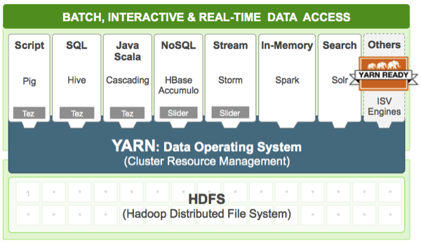
YARN: The Data Operating System
Hadoop 2.0 introduces YARN (Yet Another Resource Negotiator)
Orchestrates processing over the nodes
More than just MapReduce!
Runs a variety of applications

Slide 89

The Components of YARN
The ResourceManager communicates with the NodeManagers, ApplicationMasters, and client applications
NodeManager
ApplicationMaster
ResourceManager
Client application
Notes:
The ResourceManager allocates resources for applications but does not manage the lifecycle of applications. Instead, applications are managed by an ApplicationMaster that runs on a node in the cluster. Each application running in the cluster requires its own ApplicationMaster.

Slide 90
Lifecycle of a YARN Application
2
AM finds an appropriate NodeManager
1
Client submits an application
ResourceManager
4
3
AM asks RM for resources; RM provides a list of Containers to AM
NodeManager creates an ApplicationMaster
NodeManager
5
Containers execute their given task on DataNodes in the cluster
ApplicationMaster
Notes:
Spend as much time as you want on this slide and add details if the students want more.

Slide 91
YARN Improvements
Tez: improves the execution of MapReduce jobs, through in-memory job optimization
Slider: deploys existing 1.0 frameworks on YARN; shim for older applications

Slide 92
Demo Managing YARN Jobs
What’s running?
What ran?
Job details
Kill a running job
Doing it in cloudera Hue
Notes:
yarn application -list -appStates FINISHED
yarn application -list
yarn application -status application_1533052372690_0010
yarn application -kill application_1533052372690_0010
yarn application -list -appStates KILLED
yarn application -status application_1533052372690_0010

Slide 93
Hadoop Streaming
Create MapReduce jobs in any scripting language
Write a Mapper program + a Reducer program
Requires each NodeManager to have all the pre-requisites to execute the script
Best practice: test outside Hadoop on smaller dataset!
Notes:
Hadoop Streaming is a part of HDP, and it allows you to create and run MapReduce jobs with any executable or script as the mapper and/or the reducer. Streaming allows you to take advantage of the benefits of MapReduce while using any scripting language you like.

Slide 94
Input Split
Generates <k1,v1> pairs
Mapper
Converts the <k1,v1> pairs to lines and sends them to the stdin of the process
Converts the stdout of the process into <k2,v2> pairs
My Mapper Script
Reducer
Output Format
Converts <k2,(v2,v2,...)> pairs to lines and sends them to the stdin of the process
Converts the stdout of the process into <k3,v3> pairs
My Reducer Script
Notes:
Hadoop Streaming is a part of HDP, and it allows you to create and run MapReduce jobs with any executable or script as the mapper and/or the reducer. Streaming allows you to take advantage of the benefits of MapReduce while using any scripting language you like.

Slide 95
Running a Hadoop Streaming Job
A streaming job is a MapReduce job defined in the hadoop-streaming.jar file:
hadoop jar $HADOOP_HOME/lib/hadoop-streaming.jar
-input input_directories
-output output_directories
-mapper mapper_script
-reducer reducer_script
Notes:
For example, the following command executes a Streaming job that uses cat as the mapper and grep as its reducer:
hadoop jar hadoop-streaming.jar
-input test/data.txt
-output streamtest
-mapper /bin/cat
-reducer 'grep -i hadoop'

Slide 96
Demo: Hadoop Streaming
For example, the following command executes a Streaming job that uses cat as the mapper and grep as its reducer:
hadoop jar hadoop-streaming.jar
-input test/data.txt
-output streamtest
-mapper /bin/cat
-reducer 'grep -i hadoop'

